Slide 1
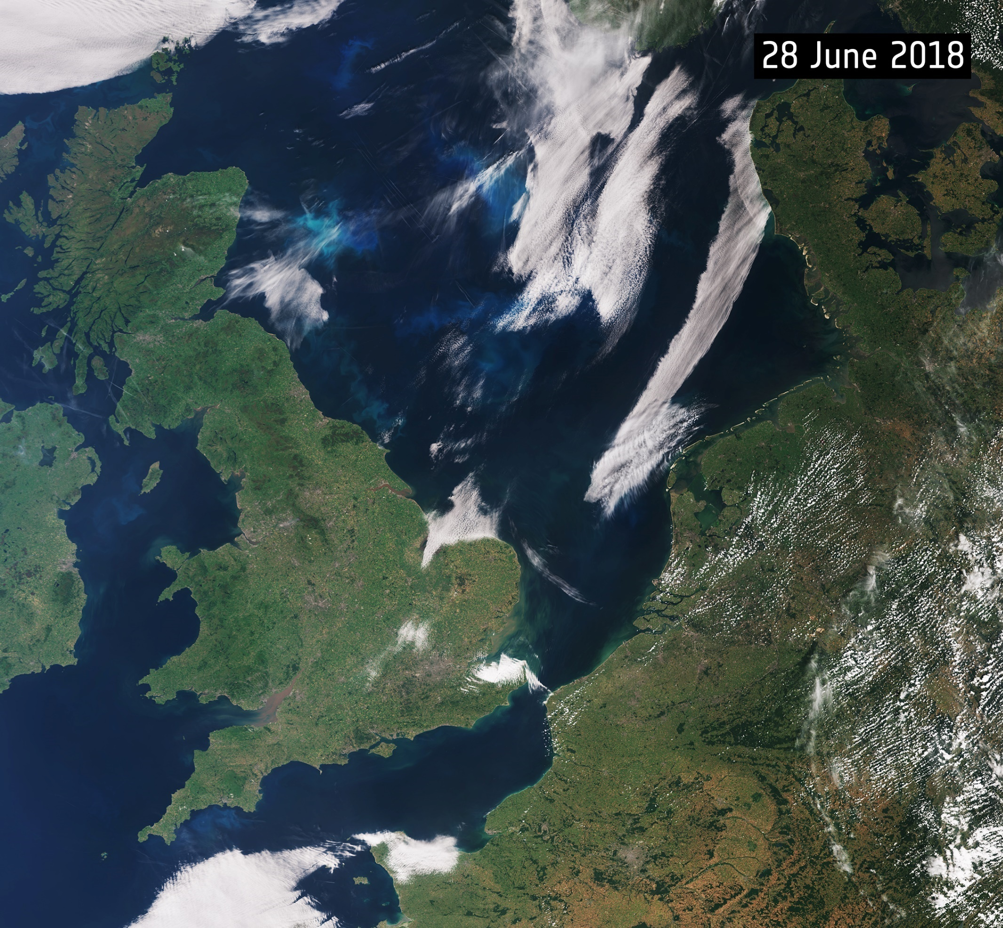
Stock Presentation
IOAG Industry Day
170919 Catherine Mealing-Jones Director for Growth
rev: 21 September 2018

Slide 2
Vision
Leading the UK into a new space age
We are responsible for all strategic decisions on the UK civil space programme and provide a clear, single voice for UK space ambitions.
We will deliver an excellent collaborative space programme with the maximum economic, scientific and policy benefit for the UK.

Slide 3
UK Industry Ambition
Size & Health of the UK Space Industry 2018
Government Policy
Transformation
Economic Success
The space industry outlines a bold partnership strategy ‘Prosperity from Space’
Notes:
As a Critical National Infrastructure, Space enabled applications and derived services in the global satellite market are used in other sectors to create £250Bn Gross Value Added (GVA)
Space Growth Partnership has ambition to see this rise to £400Bn, developing through Growth strategy and Industrial strategy. UK government has recently agreed a National Space Council.
Industrial Strategy has triggered new structures around: trade & export, inward investment, regulation, markets, skills & training, location, research & innovation, diversity, smart procurement and SMEs & entrepreneurs.
Disruptive technology in earth information services, in-space robotics, connectivity series and low cost access to space expected to realise £75Bn.

Slide 4
UK Industry Headline Figures
Size & Health of the UK Space Industry 2018
Size & Health of the UK Space Industry 2018
Notes:
Total UK space industry income grew to £14.8 billion in 2016/17, a growth rate of 3.3% per annum. At current exchange rates following the depreciation of Sterling, this is equivalent to 5.1% of the global space economy (2016/17). Income is forecasted to grow 4.8% to £15.5 billion in 2017/18.
The upstream grew strongly to £2.4 billion, though the downstream still dominates at £12.4 billion. Space Applications is the largest segment with 69% of income, of which 48% is Direct-to-Home (DTH) broadcasting. This is followed by Space Operations (15%), Space Manufacturing (13%) and Ancillary Services (3%).
Across all activities, Broadcasting dominates (51% of total income) followed by Communications (19%), Position, Navigation and Timing (12%), Defence (which has grown to 8%), and Earth Observation (3%).
Find graphic for this message

Slide 5
Increase in private funding
Size & Health of the UK Space Industry 2018
Early Stage venture capital investment, Space Angels illustration

Slide 6
UK Space Standards Industry Position
Size & Health of the UK Space Industry 2018
Space standards perform government regulatory functions (alongside space operations, spectrum, and space launch) as the critical context within which UK industry maintains and grows its global competitiveness.
Technical industrial standards expertise work in tandem with UKSA.
Rapid progress recently in number of key UK/international collaborative activities through
A new UKSA advisory body brings a cross-section of the UK community for pertinent discussion and guidance.
Notes:
UKSA often meet our commitments under various agreements, and safeguard UK’s commercial interests, through a network of contracts with highly specialised industrial providers to deliver the required range of technical support activities on our behalf.
Carefully constructed industrial partnerships -
UK industry is integrated at appropriate levels in UK Space Agency activities for the benefit both parties, to represent the UK’s interest, such as:
CCSDS technical committee’s representation is through industry (and management is via STFC, part of UKRI)
IOAG (and SpaceOps) representative is industry
European Ground Segment - Common Core (EGS-CC, an ambitious new standard to build a common system for AIT and Operations to maximise synergies/reduce costs/risks) management is industry
ESCC technical liaison is industry
The UK Space Standards Advisory Board brings together small and medium business, primes, academia and research institutions to help advise and shape standards strategic thinking.

Slide 7
UKSA Space Standardisation Context
Technology within Growth Directorate
Standards, Component and wider Technology policy and strategy led by Nick Cox and Tony Forsythe.
The Interagency Operations Advisory Group holds key importance for the UKSA and industry support UKSA is of key advantage in this.
One of a number of similar industry contractual relationships exist
All serving to improve the quality of international standardisation.
Notes:
IOAG forms a critical role for the UKSA as Inter-Space Agency standards for interoperability are an important national and international aspiration.
Industry support UKSA related to interoperability and space communications and help to coordinate roles such as our space communications policy, high-level procedures, technical interfaces etc.
Similar industry contractual relationships exist other areas involving international standards areas: ISO SC13/14, ECSS, CCSDS, EGS-CC, ESCC (SCSB, PSWG and CTB).
All serving to improve the quality of international standardisation.
ISO – International Standards Organisation (SC 13/14 Sub-Committees for Space)
ECSS – European Cooperation for Space Standardisation
CCSDS – Consultative Committee for Space Data Systems
EGS-CC – European Ground Segment – Common Core
ESCC – European Space Components Coordination (SCSB – Space Components Steering Boards, PSWG – Policy and Standards Working Group, CTB – Components Technology Board)

Slide 8
UK Regional Developments
Size & Health of the UK Space Industry 2018
Strategic Local Growth further developing space presence and investment
Raising awareness
Building communities
Supporting businesses
Notes:
Ensure that growth of the space sector is embedded in and helps to deliver Local Industrial Strategies through forging stronger and more partnerships with Local Enterprise Partnerships & Devolved Administrations.
Support more new companies and ideas into the sector through expanding the capacity and coverage of the Satellite Applications Catapult and UKSA’s successful regional programmes.
Align local and national support to ensure that infrastructure developments for the space sector have maximum impact, as exemplified by developments in GES in Cornwall - the establishment of the site as a major deep space ground station, and the business that this will create, flow directly from long-term Cornwall engagement.
Make our world leading universities and research institutes into anchor institutions that support their local space clusters through collaboration with business and the commercialisation of their research.

Slide 10
Stock Presentation
IOAG Industry Day
170919 Catherine Mealing-Jones Director for Growth
rev: 21 September 2018

