Slide 1
SPACECRAFT
OPERATIONS
Paul Collins
Head of Spacecraft Operations
IOAG – 17th September 2019.
OFFICIAL SENSITIVE.

Slide 2
the Avanti Fleet

Slide 3
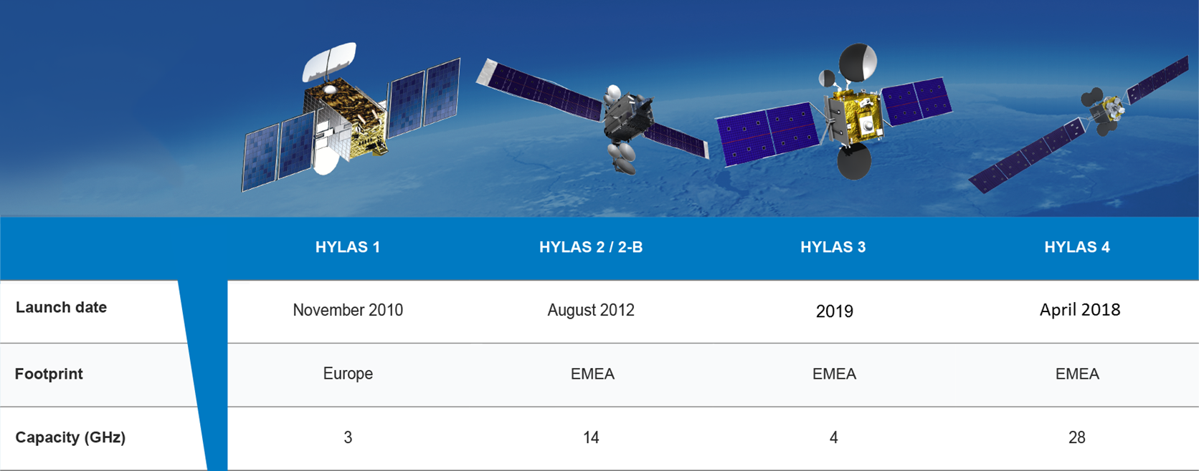
IN-ORBIT SATELLITES

Slide 4
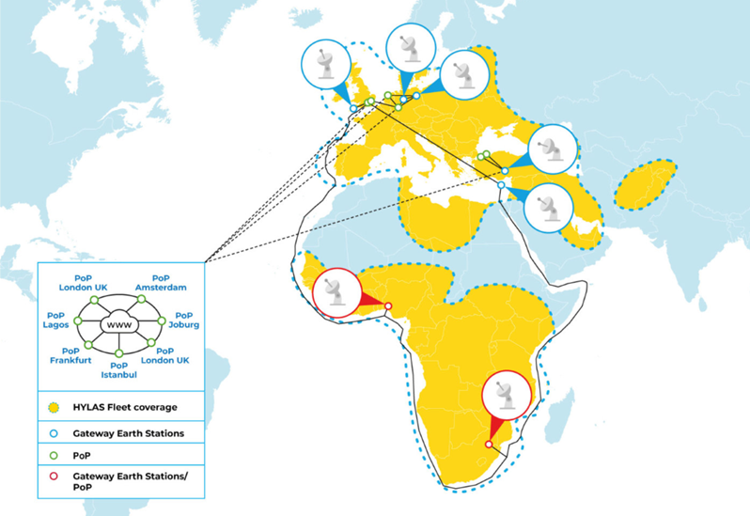
Fleet Coverage:
Europe, EMEA & Africa
12 Gateway Facilities
7 Data Centres
18 Gateway Antennas
5 TT&C Antenna

Slide 5
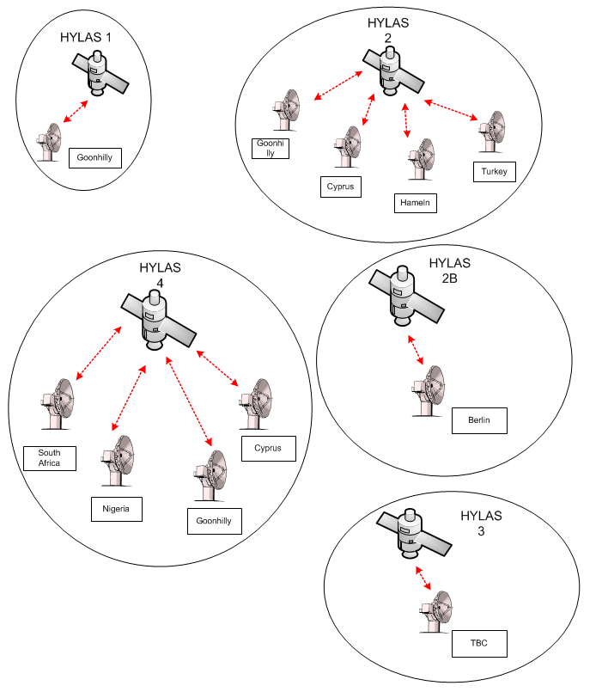
Gateway Connectivity:
Gateway sites provide the ‘forward’ service connectivity and have alternate facilities for ‘diversity’ switching in order to provide service continuity in the event of maintenance, equipment failure or inclement weather/rain fade.

Slide 6
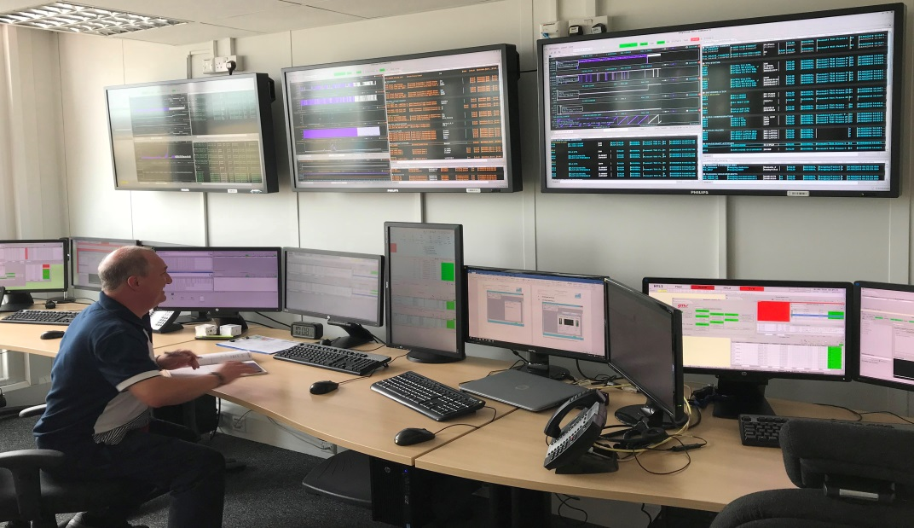
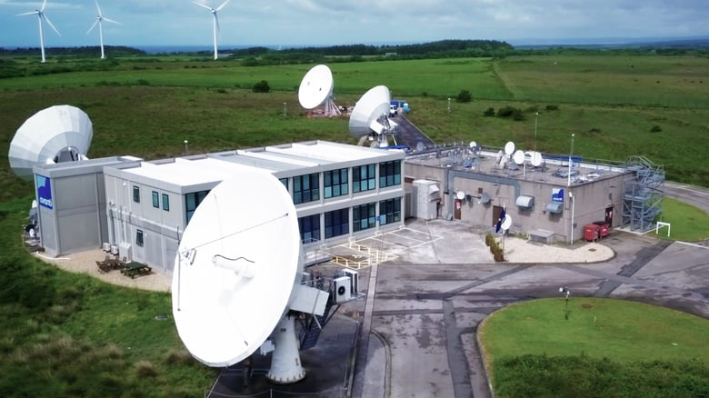
Spacecraft Operations:
Originally outsourced to Inmarsat, but taken ‘in-house’ in the first half of 2015.
Primary Spacecraft Operations Centre (SOC) is located at the Goonhilly Earth Station.
Back-Up SOC located at Avanti HQ in London & equipment located in Hameln in Germany.
Operational automation significantly reduces human intervention and hence both errors and 24 x 7 staffing requirements.

Slide 7
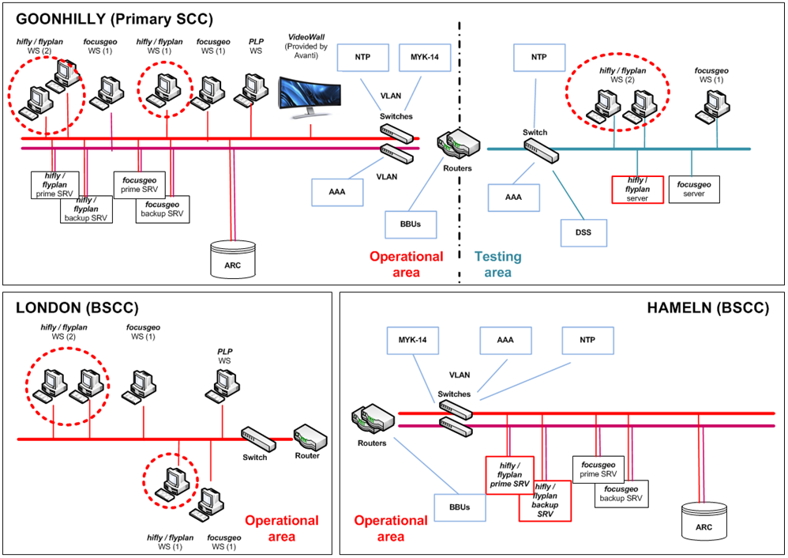
Spacecraft Operations:
GMV/HiFly Mission Control System (SCOS-2000 based) chosen to enable the operation of multiple spacecraft platforms from a single GCS platform.
HYLAS 1, HYLAS 2 & HYLAS 4 are currently operated by Avanti on the GMV/HiFly platform.
HYLAS 2B & HYLAS 3 are Avanti controlled ‘hosted’ payloads, but the spacecraft are operated by SES (Astra 5B) and DLR/ESA (EDRS-C).

Slide 8
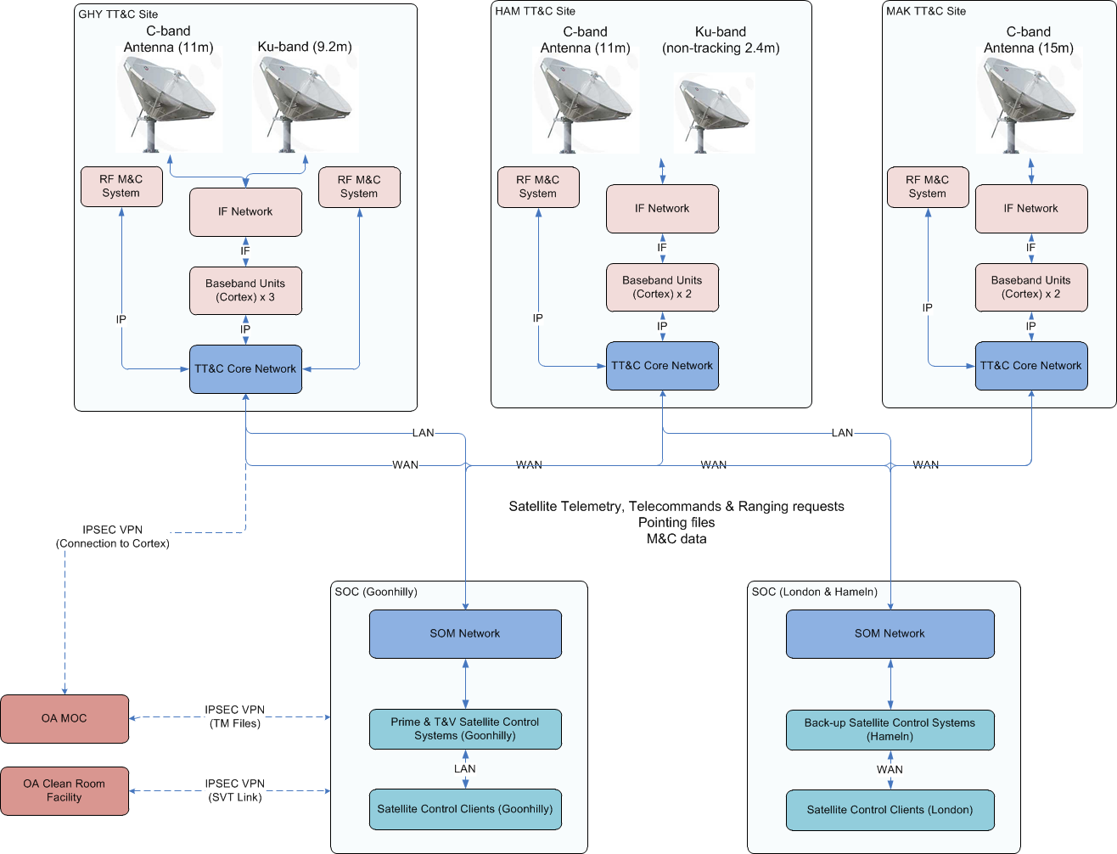
TT&C Connectivity:
All satellites in the fleet are operated by more than one TT&C antenna.
Dual-station ranging is periodically performed for each satellite.
Azimuth & Elevation data collected via the TT&C antennas is further augmented by azimuth & elevation data collected from gateway facilities in order to improve ranging accuracy and hence orbit determination.
Depending on mission requirements, WAN connectivity to external, third-party TT&C resources is also performed as and when required.

Slide 9
Spacecraft Operations:
Spacecraft Control Team (SCT)
24 x7 satellite control & monitoring
Spacecraft Operations Engineering (SOE)
Engineering support & analysis
Operations planning
Manufacturer interface
Out-of-hours on-call support
Flight Dynamics Engineering (FD)
Orbit determination
Manoeuvre planning
Conjunction analysis & avoidance
Ground Systems Engineering (GSys)
Mission Control System & infrastructure support & development
Apprentice scheme

Slide 10
Operational Evolution & Artificial intelligence
Automated Monitoring and Alert Systems
Integrate and correlate data from a wide range of systems
Alerts need to be based on information, not data.
Promotion of Automation Decision Points
Procedures often contains points that require operator input
We are moving these up the automation chain
Automated Reporting and Trending
Automated extraction and presentation of data
Automated Testing
Automated non regression testing of software releases.
Automated procedure translation, static and dynamic validation
Automated GUI testing
Decision Points
Mission Planning
Scheduling
Procedure Automation
Monitoring and Control System
Notes:
Automated Monitoring and Alert Systems
Integrate and correlate data from a wide range of systems
Alerts need to be based on information, not data.
Promotion of Automation Decision Points
Procedures often contains points that require operator input
We are moving these up the automation chain
Automated Reporting and Trending
Automated extraction and presentation of data
Automated Testing
Automated non regression testing of software releases.
Automated procedure translation, static and dynamic validation
Automated GUI testing

Slide 11
Obstacles to further operational automation:
Whilst there is a significant level of information available in the public domain, there is still a lack of centralised and current information readily available for certain activities.
Example #1:
Relocation & Flyby Coordination – Orbital relocation activity is increasing to:
Support in-orbit failures
Provide in-orbit redundancy
Re-distribute capacity
Support frequency ‘Bring Into Use’ activities
At the moment there are no regulatory guidelines to direct either flyby or relocation coordination activities, so many operators currently coordinate under a ‘best practice’ environment. Some do not coordinate at all. In order to reduce the manual workload involved and also the potential for both situational and frequency interference, the following are required:
Operational coordination to provide a centralised database of both operator contact information and accurate locations of all space assets.

Slide 12
Regulatory Cooperation:
In-line with the ‘FLYBY’ example provided in the previous slide, industry self regulation could help to ensure that all operators notify and coordinate under a standardised procedure/process.
The recent avoidance manoeuvre performed by ESA on the Aeolus weather satellite in order to circumvent a potential collision with a SpaceX Starlink satellite further highlights this problem.
Frequency Spectrum is a hot topic in the age of 5G. Regulatory (and operator) cooperation to lobby for continued interference free access to feeder-link GES spectrum is required.
Cooperation with other operators to emphasise the value of satellite in everyday life and its indispensable role in bringing future, ubiquitous, access for people in both underserved and unserved areas on all continents.

Slide 13
Conclusion
Avanti Communications fully supports operational cooperation at all levels
Currently provides a Standard Member Director to the Space Data Association (Mr. Lorenzo Arona).
Avanti Communications feels that the IOAG should be more involved at an international level regarding interoperability between Commercial satellite operators as well as between Agencies.
Notes:
Automated Monitoring and Alert Systems
Integrate and correlate data from a wide range of systems
Alerts need to be based on information, not data.
Promotion of Automation Decision Points
Procedures often contains points that require operator input
We are moving these up the automation chain
Automated Reporting and Trending
Automated extraction and presentation of data
Automated Testing
Automated non regression testing of software releases.
Automated procedure translation, static and dynamic validation
Automated GUI testing

Slide 14
Be More

