Slide 1
IOAG – Industry Exchange Workshop
Standardized Interfaces: Experiences and Ideas
Sasikanth Bakkavemana, Heiko Müller, Roger Barnes
Tuesday 17th September 2019, Goonhilly Earth Station, Cornwall, UK

Slide 2


Control Centre Point of View
FDS
Collision Avoidance
(CDM, SDO, JSPOC, DISCOS,…)
PLENITER®
Orbit
MCS
Control Centres
TM/TC
(SLE,…)
(Cross-Support) Service Providers
PLENITER®
Control
MPS
Ranging & Tracking
G/S M&C, Planning&Scheduling
PLENITER®
Plan
CCSDS 921.1-R-2
CCSDS 901.0-G-1

Slide 3
Improvement ideas
Open testing facilities*
G/S certifications
G/S as a Service (AWS Ground Station)
Pooling and Sharing Hubs (ESA 4S)
Increased standardization for Collision Warning
* Example: https://www.ssllabs.com/ssltest/analyze.html?d=goonhilly.org
Notes:
Connection ESTRACK with russian G/S (Bear Lakes + Kalyazin) during MEX was fairly complex
G/S certification could be interesting. 2 antennas will be built for H2Sat. They cannot be used immediately for other missions.

Slide 4
Satellite Roaming
ESA Study: Uninterrupted Hand-Over between Ground Stations during Immersive Telerobotics Real-Time Control Phases (UINTGS)¹
Conclusions:
  Uninterrupted TC uplink handover between ground stations is possible
  Allowed update range for IFMS² has to be changed
  Central TC uplink service is suggested
¹ M. Plura, S. Marti. UNINTERRUPTED UPLINK HANDOVER BETWEEN GROUND STATIONS, 2016 / METERON
² Intermediate Frequency Modem System
Notes:
Extract from paper: “For today’s satellite missions the ground station coverage is ‘manually’ calculated and the ground stations and antennas are booked as required for the mission. The connections to the different ground stations and by that to the spacecraft are managed by the mission itself. Knowing that also an uninterrupted handover can be achieved, a central service ensuring a TC uplink could be established offering a central TC uplink service. The missions subscribing to this service would then not be forced to check ground station coverage themselves, but could send a TC and the central service would ensure that the command is uplinked as required.”

Slide 5
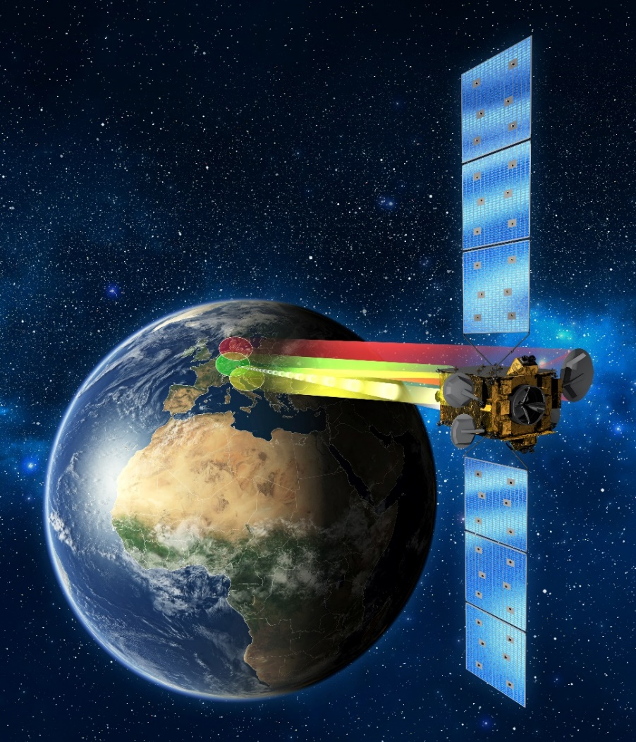

Related SCISYS activities
DLR: Heinrich Hertz
ESA: UINTGS / METERON
DLR: DEOS
ESA/EC: Govsatcom ARTES 4S
ESA: TTCP (maintenance by SCISYS/BAE)
PLENITER®
Notes:
TTCP (Telemetry and Telecommand Processor): replaces among others IFMS; Cortex is internationally acknowledged but misses performance especially for DeepSpace missions; currently 3 ESTRACK G/S are equipped with TTCP

Slide 6
Backup slides

Slide 7


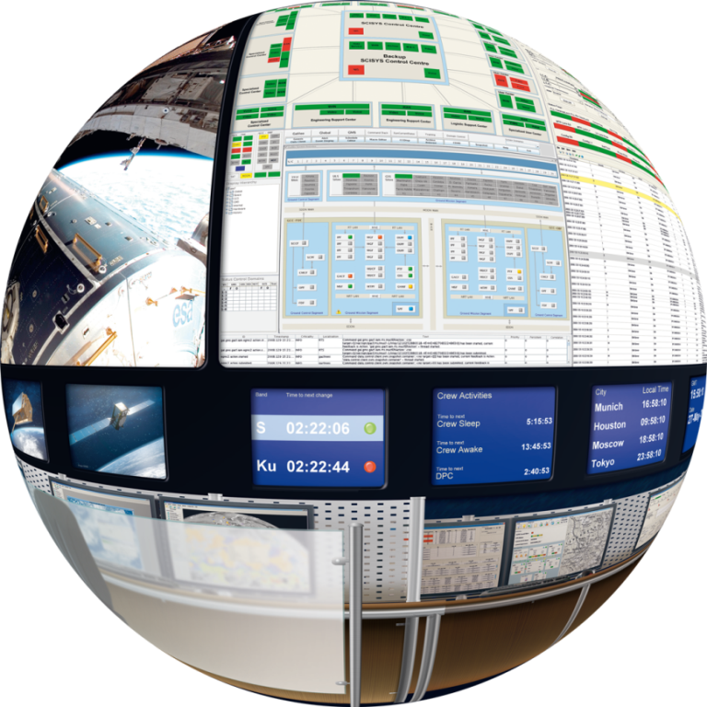
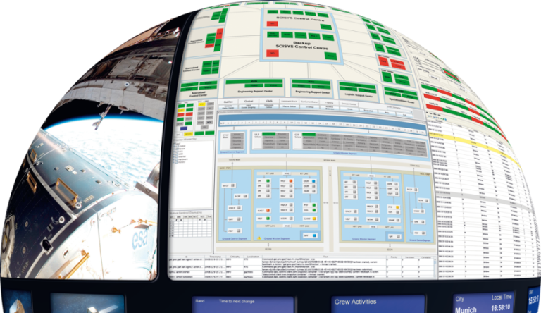






The PLENITER® Modules
PLENITER® AUTOMATE
The Advanced Set of Tools for the Automation of Space Mission Control
PLENITER® ORBIT
The Integrated Flight Dynamics Solution
PLENITER® PLAN
Operations Schedules for Single or
Multi-Spacecraft Missions
PLENITER® CONTROL
Integrated Monitoring and Control Core for Space and Ground Systems
PLENITER® STORE
Centralised Mission Archive, Configuration and Product Store
PLENITER® PAYLOAD
Payload Planning, Monitoring, Control and Analysis

Slide 8
PLENITER® Suite Overview
The PLENITER® software suite is designed on a modular basis and can be adapted to meet the needs of different operations scenarios.

Slide 9
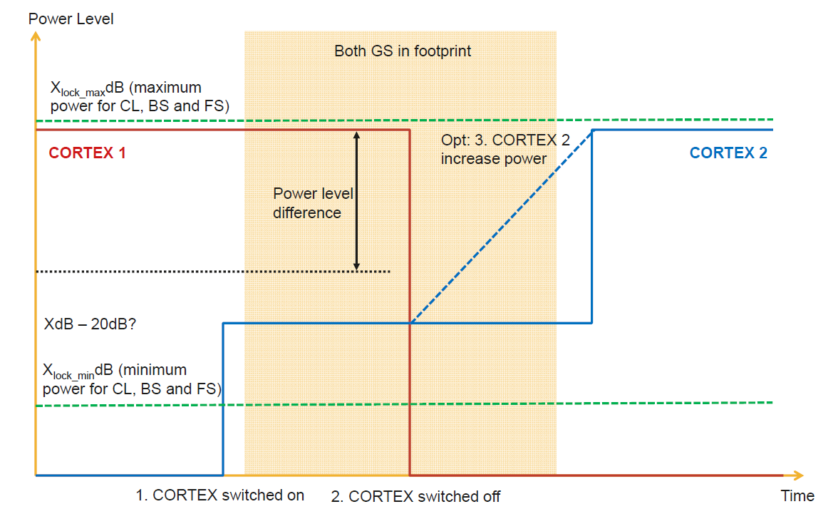
UINTGS Link Characterisation – Approach and Key Parameters

Slide 10
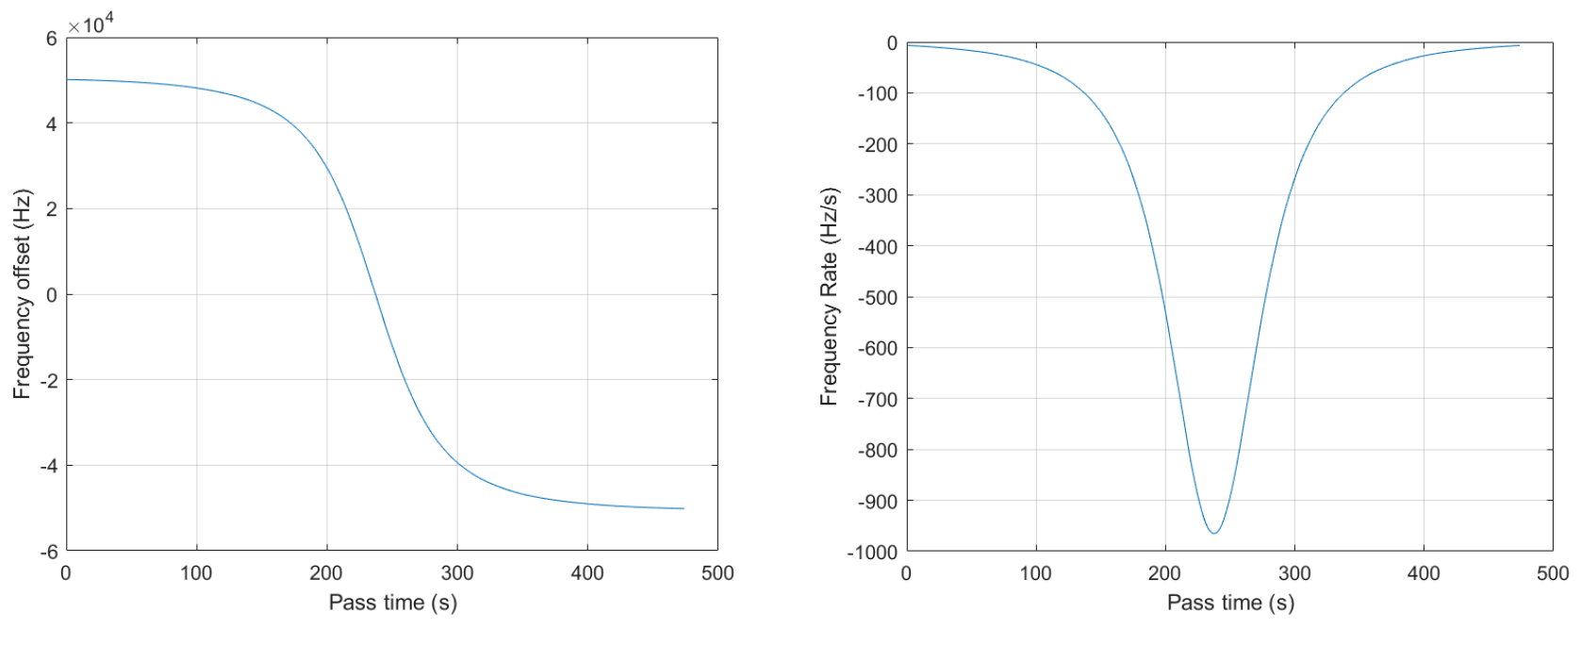
ISS Pass – Doppler Frequency Offset and Change Rate

